Slide 1


Town Square Health: Primary Care 3.0 for Medicare

Slide 2
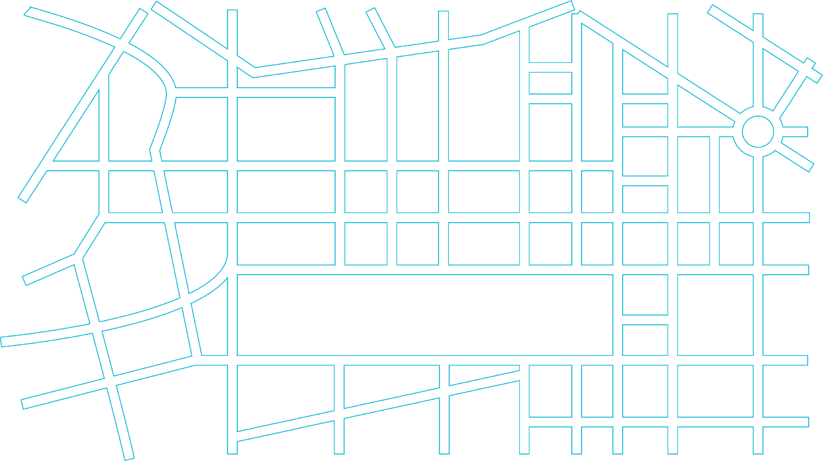




EXECUTIVE SUMMARY
Town Square Health is Primary Care 3.0 for Medicare
Physician-led and tech-industry built. We pair a frontier LLM with a simplified care team — one PCP and one Navigator — to deliver a new gold standard of primary care to a market still underserved by advanced value-based care.
THE OPPORTUNITY
THE MODEL
WHY WE WIN
THE ASK
A large, growing market — barely served.
An AI-powered, multi-specialty practice.
Better unit economics, led by operators who've done it.
Be part of establishing the new gold-standard.
Medicare is expanding fast, while advanced value-based primary care has reached almost no one.
A single PCP, supported by AI agents and live telehealth specialists, carries the patient relationship.
Value-based capitation is the unlock that lets us deploy AI at the center of care delivery — not just in the back office.
$15M
SEED ROUND
CLOSING MARCH 2027
Frontier LLM + full patient context — clinical, social, and functional, integrated in real time
Open three Primary Care 3.0 health centers
68.9 M
Medicare enrollees in the addressable market
20 %
Lower capital required vs. comparable VBC peers
Build SquareOne, the proprietary tech stack
One PCP, one Navigator — fewer handoffs, deeper trust, longitudinal care
8 %
Annual growth in Medicare spending
15 %
Quicker to breakeven
Launch automated Central Operations
Telehealth specialists in-room with the PCP for unified care plans
<5 %
Share of Medicare in globally capitated PCP practices
25 %
Higher 10-year profitability in our market models
Recruit Clinicians, Navigators and Growth teams
Clinician oversight on every AI use case — exam room, at home, and population health

Slide 3
Primary Care 3.0 - A new chassis for driving VBC results in Medicare

Slide 4
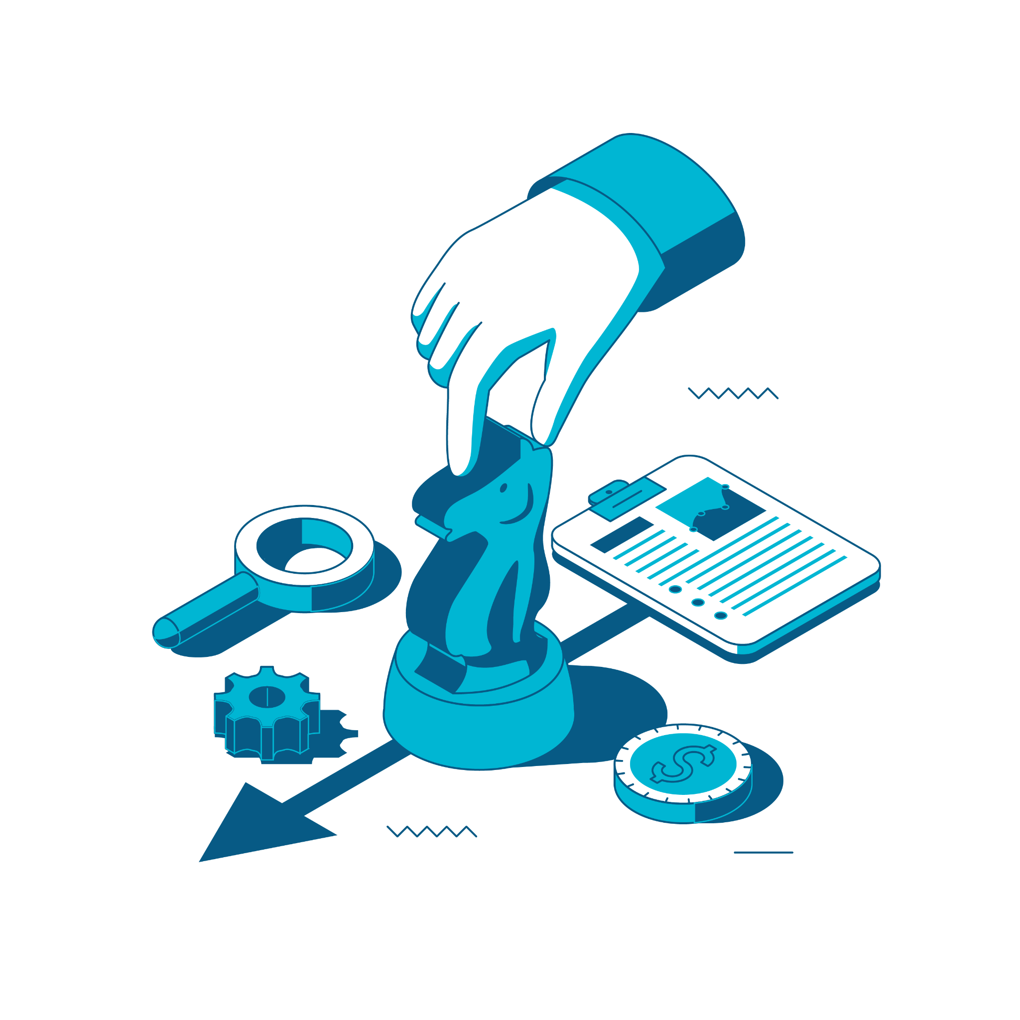




Primary Care 2.0 was a step change
Primary Care 3.0 is a generational leap

Slide 5
THE MODEL
Primary Care 3.0: an AI-powered, multi-specialty practice
Clinicians, Patients and AI collaborate to achieve VBC outcomes — with each reinforcing the effectiveness of the others
PATIENT
Patient, family & community
Caregivers and social supports — family, community, and trusted relationships — engaged alongside the patient.
AI Tailored to the patient
Comprehensive context engineered in SquareOne
Family / Caregivers can join visits
Strengthening supports for patient’s health journey
Care guided by AI
For patients, caregivers and clinicians
Trust & shared decisions One PCP, longitudinal care
Scope expands + Agentic support
Care provided across cognitive specialties + enhanced ops efficiency
Clinical Support
CARE TEAM
AI model + live specialists
PCP, Navigator & Nurse
AI-forward support with eConsults and live telehealth specialists for escalations.
One team carries the patient longitudinally — with expanded scope across cognitive specialties.
Clinician oversight extends every AI use case Safe, supervised AI in every venue of care

Slide 6
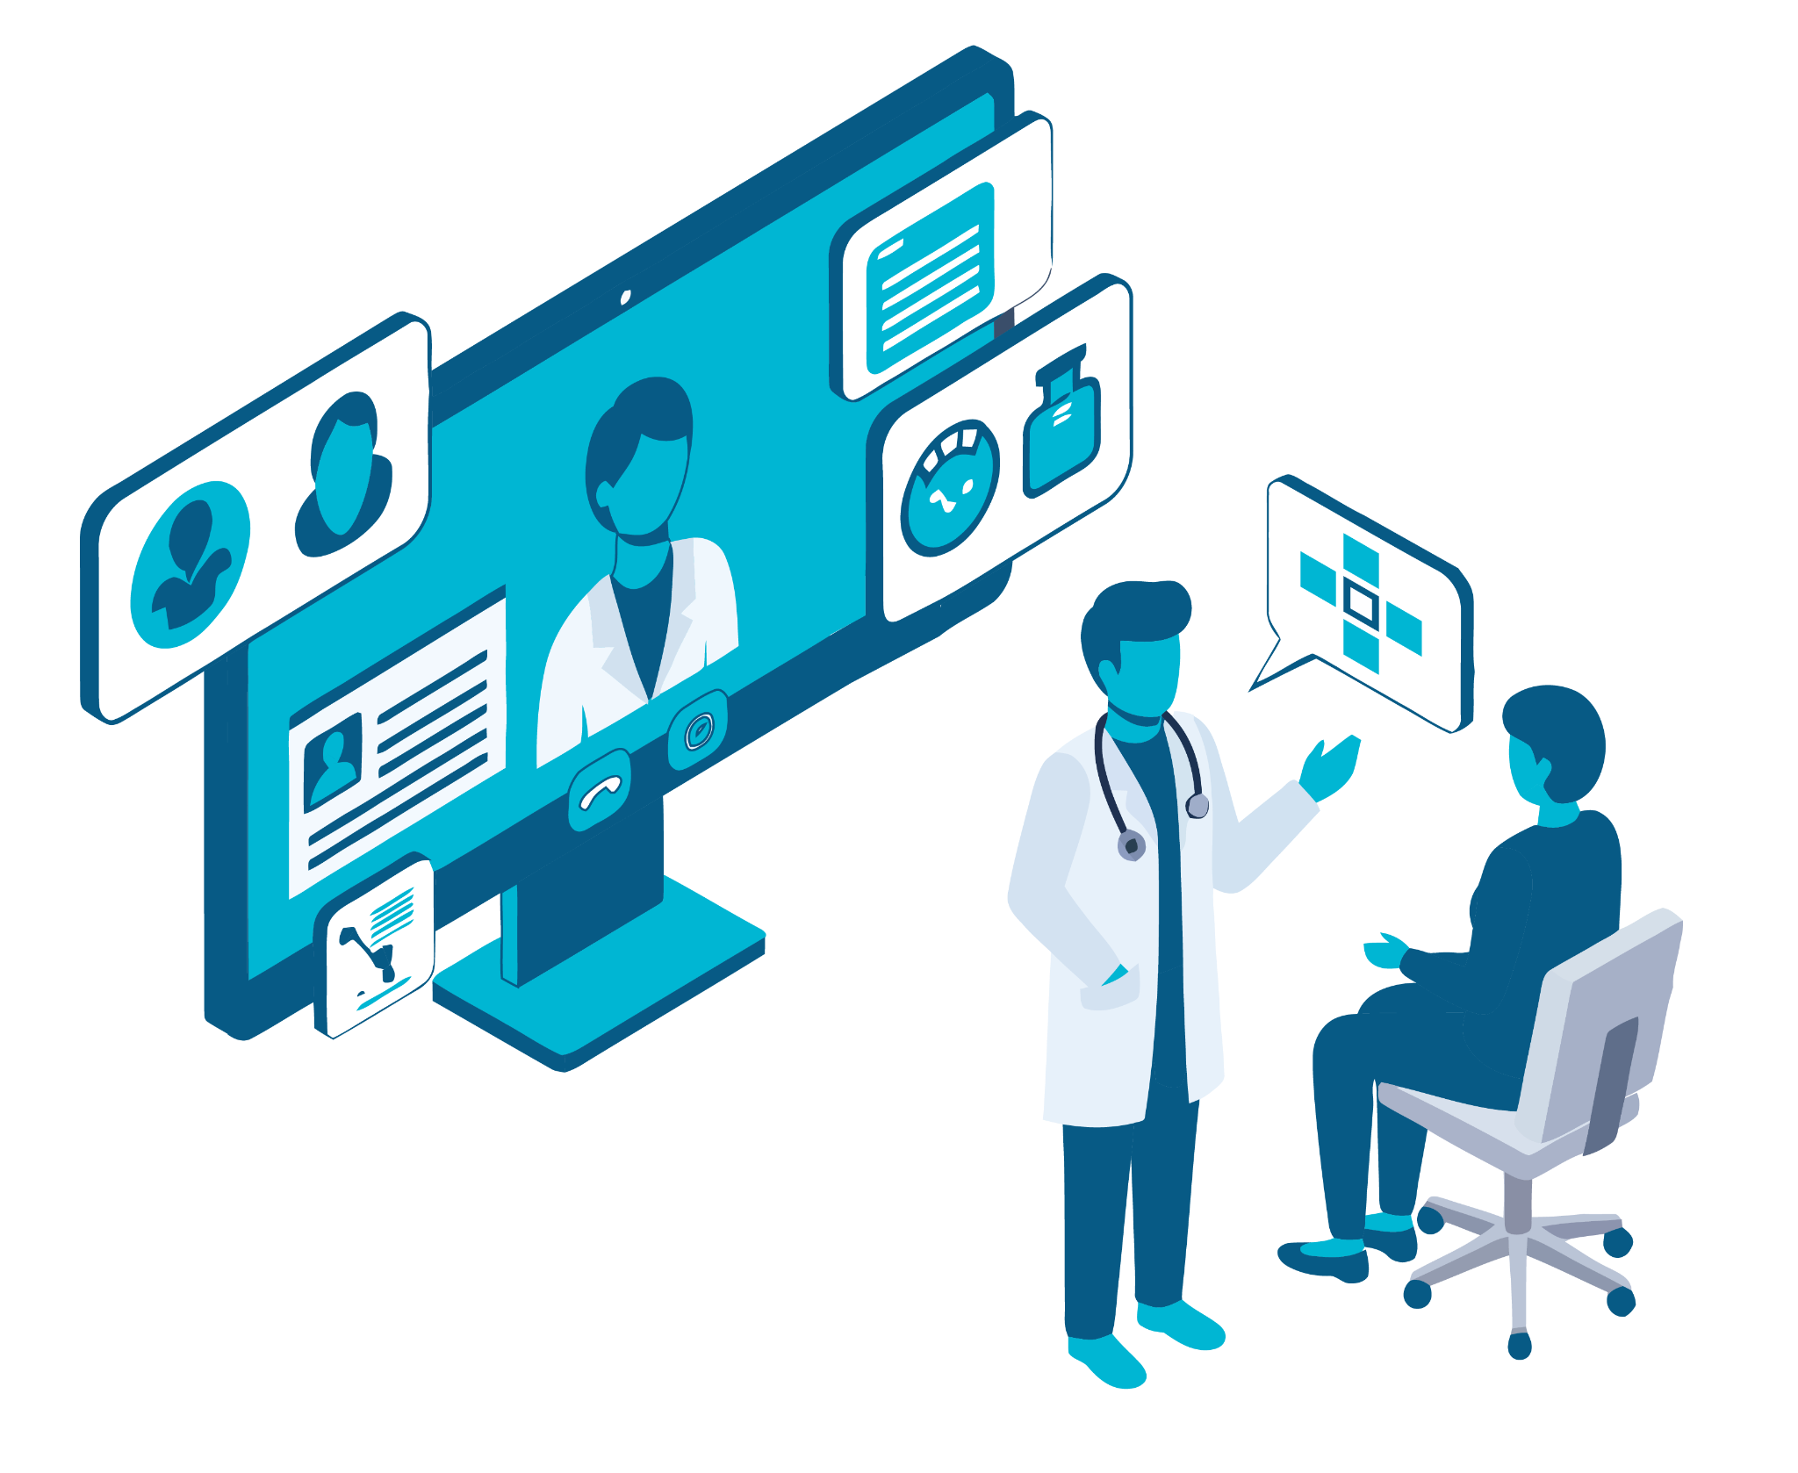
Our Model of Care
Includes all elements of a robust, comprehensive
care model, built to deliver best-in-class results.
Strengthens patients’ longitudinal relationships with the care team by delivering all elements of care through one PCP and one Navigator.
Leverages AI Agents & LLM Clinical Decision Support to empower the PCP and Care Navigator to cover an expanded scope, reducing complexity and lowering costs.
PCP and Patient see telehealth specialists together achieving a unified care plan and an unmatched patient experience.
The Result
Better experiences, stronger relationships, and healthier patients.

Slide 7
AI unlocks the future of care delivery

Slide 8
We use Frontier LLMs with our context and clinician oversight
A best-in-class LLM, paired with our VBC and Tech engineered context elevate care and efficiency across the enterprise. A clinician supervises every use case. Value-based care lets us deploy what fee-for-service can't.
Frontier LLM - ANTHROPIC · CLAUDE
+
Patient Context - Town Square Health
FFS will not move beyond back office AI without answering…
Broad knowledge and Reasoning
Clinical · Social · Functional
Best-in-class LLM partner.
Longitudinal record, care-team observations, patient-reported signals.
Integrated in SquareOne
Who pays for AI Implementation? Under FFS, new innovations must increase productivity or be incrementally billable to be implemented in core care delivery
Who pays for the human in the loop?
AI is powerful, but makes mistakes and doesn’t have a medical license to carry out clinical actions
Who pays for the incremental Malpractice Coverage?
One Model - A Unique LLM for each patient
Town Square Health engineered patient-specific context synthesizes clinical, social, functional, and community information in real time leveraging an advanced data architecture. Model output is tailored to the audience (clinician, navigator, patient) and the surface (search, chat, assistant).
Clinician oversight - Extends the AI Use Cases safely
Each patients PCP and supporting staff will oversee AI clinical guidance in the center and when the patient is home. This enables immediate care team action when needed. Think, “Your PCP / Nurse has entered the Chat”. Our focus on close relationships between patients and their care teams plus our small VBC panel sizes position us to fully test this approach.
The VBC UNLOCK
Tech-forward, globally-capitated primary care groups have the resources and the aligned incentives to enable deployment of AI centered care delivery now

Slide 9
One Model - Many Venues
An AI model tailored to each patient’s full clinical, social and functional context, empowers care in the exam room, drives population health campaigns, streamlines operations and supports patients at home.
Exam Room
At Home
Population Health
Central Ops
Provides real-time clinical decision support
Surfaces relevant history, gaps in care, & evidence-based guidance
Supports patients and caregivers 24/7
Care Team monitors the chat assuring quality & safety
Identifies patient interventions
Monitors between visits and flags for touchpoints
Automates Tasks:
Voice Calls, Referrals, Med Records
Improves timeliness and lowers costs

Slide 10
Our centers are purposely built to support Primary Care 3.0
Designed for how clinical care will be provided when serving Medicare patients in the era of AI
Enhanced Audio Capture
Telehealth forward exam rooms
Space Design & Equipment
Using professional microphones instead of laptop or cell phone mics will improve the quality of information gathered during clinical encounters for writing notes and for additional patient context.
Exam room monitor placement will allow natural conversation with the PCP, patient and telehealth attendees. Attendees may include live specialists, family and friends.
Monitors will also display real time AI support, tracking next steps and decision support. This creates transparency and builds trust.
Team spaces designed to facilitate Care Teams working together to manage their patients - both in and outside of the center.
EKGs, Echos, Spirometry, Cognitive Testing, Accurate Vitals, blood draws, and more are provided in-house to allow for successful delivery of Value Based Care

Slide 11
Capital Efficiency and Unit Economics

Slide 12
ADVANCED ANALYTICS & AI
We chose our markets — and sized our capital — with a proprietary simulation engine.
The MegaCalculator is Town Square Health's 10 year, month-by-month financial simulation and market-selection platform. It's the analytical backbone behind every major capital, payer, and market decision we've made.
Configurable inputs
ANY MARKET, ANY PAYER
SIMULATION ENGINE
Decision-grade outputs
PER MARKET, PER PAYER, PER MONTH
Market & demographics
120-month, deterministic, sub-second.
Medicare population, MA penetration, addressable carrying capacity per MSA.
Capital
Peak capital & timing
CURVE
Sized capital raise and the exact month of the cash-flow inflection.
Payer mix & contracts
A configurable scenario layer feeds a high-performance engine that simulates revenue, costs, capital, and patient growth at monthly granularity — fast enough to run thousands of sensitivity tests in minutes.
Per-payer share, risk thresholds, and unique contracted PMPM rates.
P&L
Month-by-month P&L
→
→
PER LOCATION
Per-location revenue, contribution margin, and break-even path.
Patient growth model
Proprietary ML model predicts baseline growth rates for any US GPS coordinates.
PMPM
Payer negotiation
HORIZON
120 months · 10 years
LIVE MODEL
Live impact of any proposed PMPM, risk threshold, or contract structure.
Staffing & cost structure
Month × Location × Payer
Care-team ratios, central staffing, fixed/variable opex, CapEx, AI tokens.
GRANULARITY
RUN TIME
< 1 second per scenario
Δ
Scenario comparison
RAF ramp & reinsurance
New scenario in one config file
SENSITIVITY
Vary one input — capitation, growth, staffing — and compare runs side-by-side.
RAF curve from 0.90 → 1.55 plus tiered reinsurance based on lives at risk.
SETUP
HEADLINE
$50 M
46 Months
$7 M
$52 M
WHAT IT POWERS
Rochester / WNY
6 Center scenario
CAPITAL Required
to CASH-FLOW POSITIVE
Annual Profits in Year 5
Annual Profits in Year 10
Market selection — capital & break-even for any candidate MSA.
Capital planning — peak need and inflection timing for the raise.
Payer negotiation — bottom-line impact of every PMPM proposal.
Operational planning — staffing build curves & capacity utilization.

Slide 13
PC 3.0 VS. PC 2.0
Where Primary Care 3.0 outperforms the prior generation.
Across operating costs, total cost of care, and patient engagement , the AI-powered care team delivers step-change improvements over the legacy VBC model and bends the J‑curve.
Operating costs
LOWER RUN-RATE
Total cost of care
LOWER MLR
Engagement
HIGHER QUALITY & TRUST
80 %
Central operating costs
20 %
Specialist spend
10 %
Annual Wellness Visit completion
AI agents replace centralized back-office staffing for scheduling, intake, prior auth, documentation, RCM. Legacy VBC run these with seven to nine figure HQ teams.
Telehealth specialists join the PCP visit on demand, expanding PCP scope and producing one unified care plan with fewer redundant referrals and overutilized specialty visits.
AI-driven outreach campaigns, personalized scheduling nudges, and a trusted PCP relationship lift completion rates to drive HCC accuracy and Stars quality.
REDUCTION
REDUCTION
INCREASE
15 %
Center care-team cost per patient
25 %
Patient satisfaction
One PCP plus one Navigator, with AI-supported scope, replaces the legacy model's expanded center staff. Same panel size, leaner team, deeper relationships.
45 %
Total hospitalizations
One PCP, one Navigator, in-room specialty access, and 24/7 care-team chat eliminate the navigation burden patients carry today and it shows up in CAHPS and NPS.
REDUCTION
Versus fee-for-service models, and improving over legacy VBC. Stronger longitudinal relationships, 24/7 AI patient support, and proactive population-health outreach catch acute exacerbations early and keep chronic conditions controlled.
IMPROVEMENT
REDUCTION
40 %
Regional leadership cost
A simplified, standardized operating model with fewer roles per center, AI-orchestrated workflows which means fewer regional managers needed to run a portfolio of centers.
REDUCTION
→
Lower costs, healthier patients, deeper trust — the three forces that compound to shift the J‑curve we'll walk through next.

Slide 14
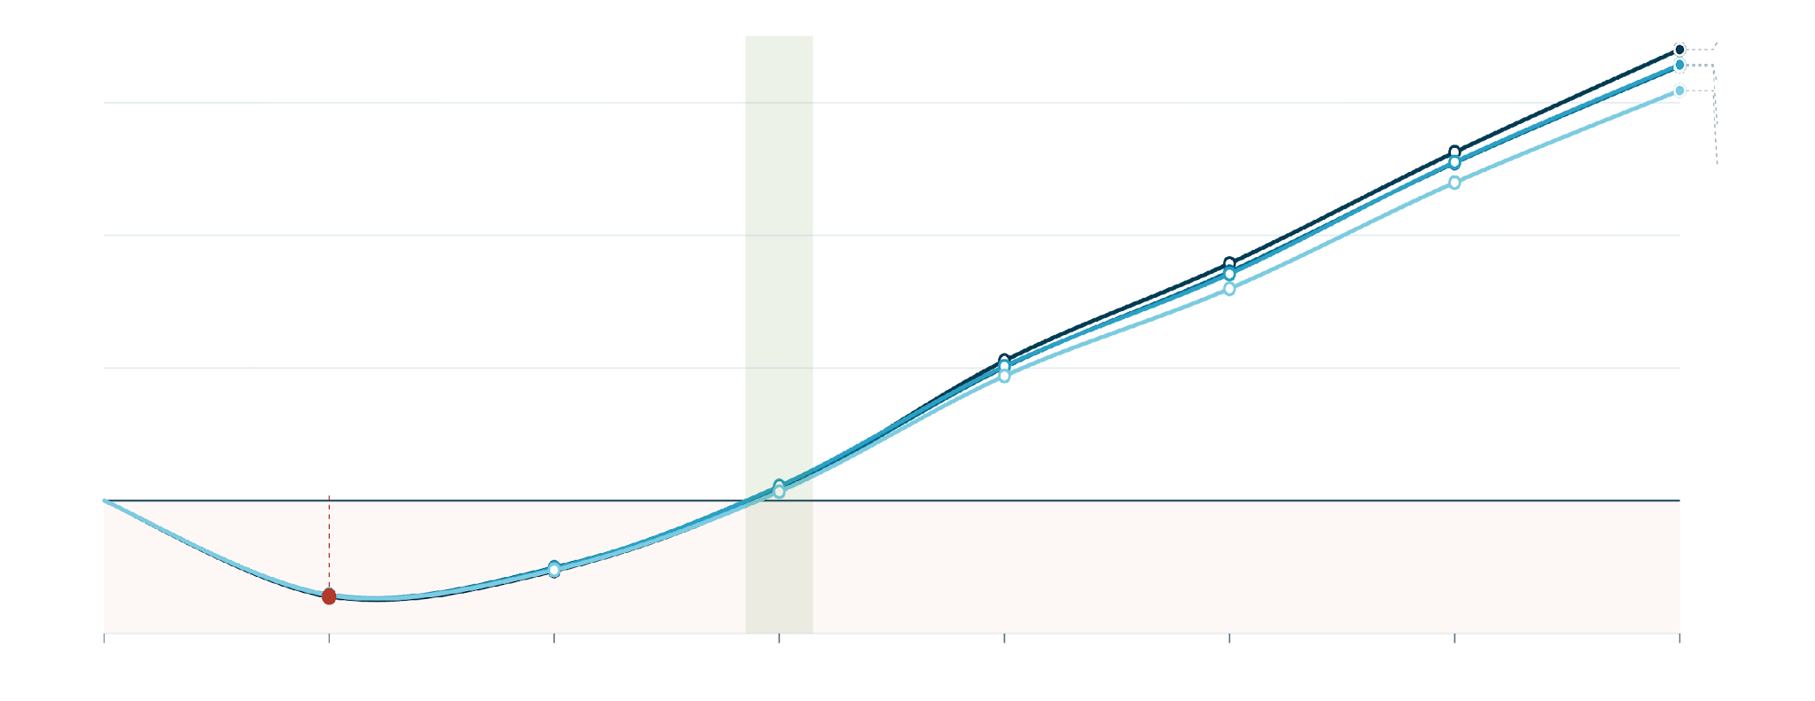
LOCATION ECONOMICS · ANNUAL OPERATIONAL NET
Each new location traces the same J‑curve
Faster Growth & Higher Retention
Lower Operating Costs
Improved RAF Accuracy
Lower Medical Loss Ratio (MLR)
Profitability in year 3
L3
$6M
L5
L4
L6
$4M
ANNUAL OPERATIONAL NET (USD)
$2M
Trough in year 2
$0
≈ −$1.4M annual
−$2M
Open
Year 1
Year 2
Year 3
Year 4
Year 5
Year 6
Year 7
TROUGH
RISK CONTRACT ACTIVATES
FIRST POSITIVE YEAR
L3
L4
L5
L6
Year 2 · ≈ −$1.4M
Year 1 (all)
Year 3
x-axis: years since opening · annual operational net (Σ 12 months) · data through May 2026

Slide 15
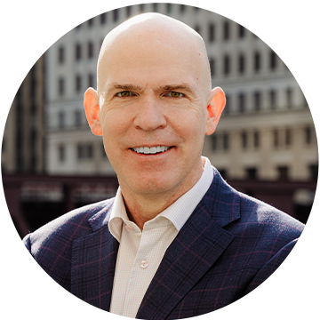
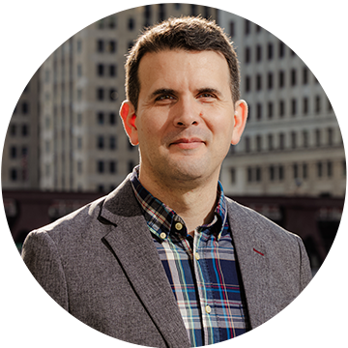
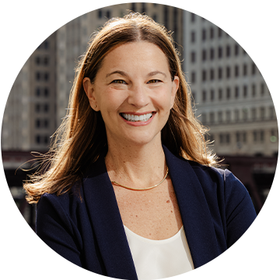
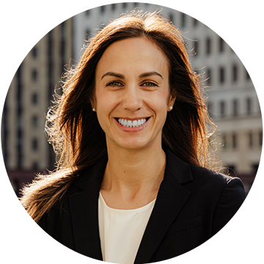
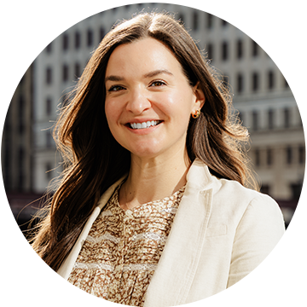









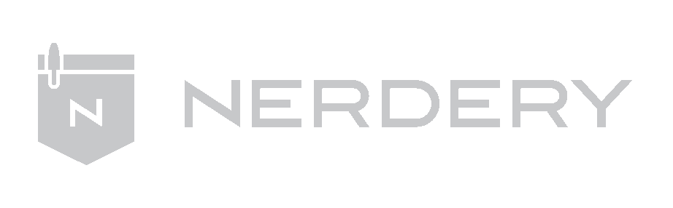

We are prepared to succeed. Our team combines deep clinical, operational, and technology expertise.
David Buchanan, MD, MS
Marshall Glanzer
Lauren Ranalli, MPH
CEO, Co-Founder
Chief Technology Officer
VP, Community and
Patient Engagement
Ellen Wagner, MPH, MS
Fiona Weber, MHA
David Qu, MBA, FACHE, FACHDM, CPHQ
VP, Operations
VP, Provider Strategy and Population Health
Senior Strategic Advisor
Our Backgrounds

Slide 16
THE ASK
Help us open the first Primary Care 3.0 health centers in America.
WE ARE RAISING
15M
$
We're raising our Seed round to launch three flagship centers, build out our proprietary SquareOne AI platform, and recruit the founding clinical team that will define a new gold standard of care.
SEED ROUND
CLOSING MARCH 2027
Use of funds
ALLOCATION OF $15M
45%
25%
20%
10%
Open three flagship health centers
Build the SquareOne AI platform
Recruit the founding clinical team
Patient growth & market launch
Buildout of purpose-designed Primary Care 3.0 centers, including telehealth-forward exam rooms.
Our proprietary stack pairs a frontier LLM with full clinical, social, and functional patient context.
PCPs, Care Navigators, and Nurses who will set the bar for how Medicare patients experience care.
Community engagement and marketing analytics to drive accelerated patient growth.
• Site selection & lease build-out
• Telehealth-equipped exam rooms
• Professional audio & team spaces
• Clinical context engineering
• Population health AI agents
• Patient & care-team chat surfaces
• Founding PCPs & Navigators
• Clinical leadership & supervision
• Training on the AI-supported model
• Community engagement programs
• Market analysis software
• Payer contracting & credentialing
WHAT THIS FUNDS
Q3 2026
Q1 2027
Q2 2028
18-month milestones
SquareOne platform v1 deployed in pilot
First flagship health center open & seeing patients
Three centers live, and on to Series A

Slide 17
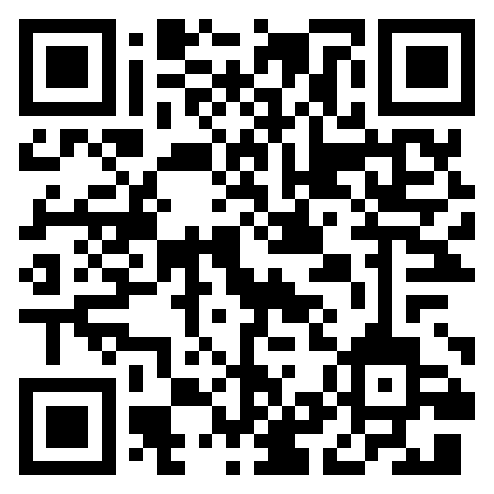
We are the future of Primary Care Healthcare
Contact Us
David Buchanan, MD
CEO, Co-Founder

Slide 18



